Slide 1
Partnership Proposal Presentation
NMBC Moving Solutions
Presented by: Team 10
Young Roh, William Wang, Kaitlyn Persaud, Adam Fik

Slide 2

NMBC Moving Solutions
What is the company?
Moving company specializing in local and interstate moves for homes, apartments, offices, and universities.
Contact Information:
Address: 454 Morris Ave, Springfield, NJ 07081
Phone: (551) 220-6750

Slide 3

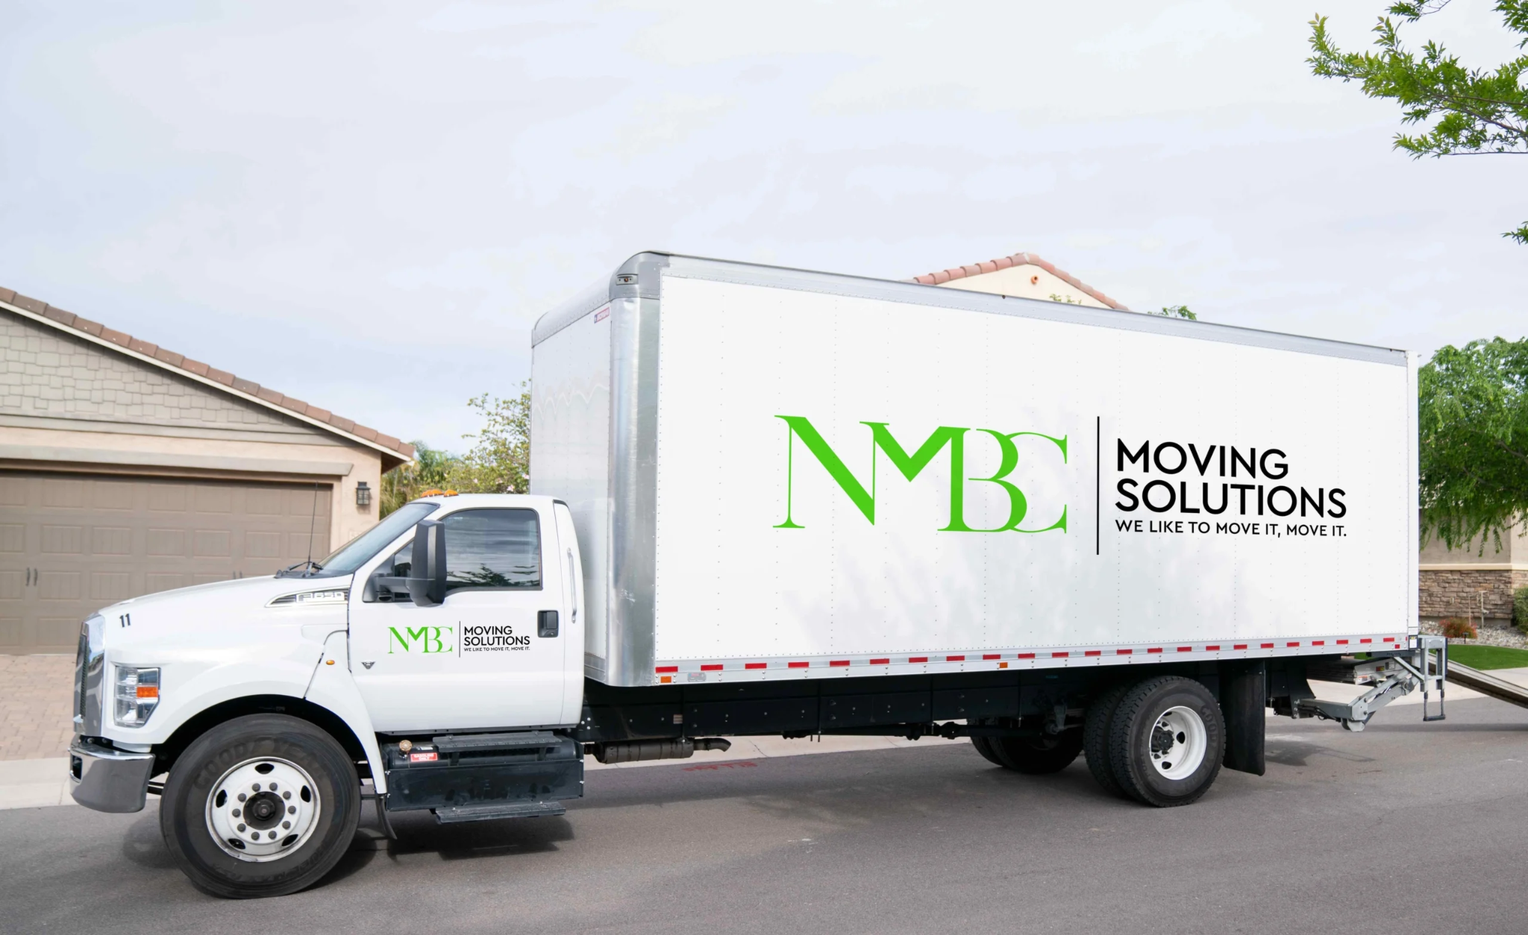
Background Information & Secondary Data
NMBC Moving Solutions is a 3 year old moving company founded by 4 former college roommates who all played soccer together.
Mission: NMBC specializes in small and residential moves throughout New Jersey. Their goal is to provide efficient and stress-free moving services.
Competition: Since the company is relatively new to the moving industry and working mainly in Central Jersey, its competitors are mostly local with some being Piece of Cake Moving and Chatham Moving.
Size & Demographics: The company consists of 16 employees who are all men aged between 21-28 years old. Most of the workers are made up of White males, with the minority identifying as Black and Hispanic.

Slide 4
Data Collection Methods
Qualitative Interviews
Secondary Data Research
Preliminary Interview
  Nick Halpin (COO)
  Allowed us to get initial information on the company (history, staff structure, etc) and identify leads on problems
Secondary Interviews
  Brandon (supporting manager)
  Zach and Carson (staff members)
  Allowed us to compare perspectives between management and employees
Secondary Sources
  Sources such as industry reports and reputable websites provided additional information on the moving industry and its trends/demand patterns
Information provided informally
  Additional information provided by Nick Halpin (COO) between formal meeting times
  Gave us more insight on scheduling and staffing

Slide 5



Timeline
Initial Interviews (Nick)
Interviews With Management (Brandon)
Interviews With Staff (Zach and Carson)
Closing Interview (Nick)
Our mission
September 28 and October 1
October 7 and October 14
October 20 and October 29
November 7
Overall goals
Initial information on the company itself
Company group dynamics
Previous resolved/unresolved issues
More insight into the management side of the company
Potential issues with team members
Relationship with management
Personal issues with staff and management
How to proceed
Enforcing boundaries

Slide 6
Output Problem
Motivation and accountability
Employees are displaying inconsistent effort, uneven workload, and fluctuating performance
Little connection between effort, performance, and reward
Some employees report having to “pick up the slack” because others are only doing the bare minimum

Slide 7
Output Problem #1 - Expectancy Theory
The Expectancy Theory is made up of three parts: Expectancy, Instrumentality, & Valence
1
2
3
Expectancy
The belief that putting in effort will result in a successful performance.
Valence
The value that an individual places on the anticipated reward/outcome.
Instrumentality
A specific level of performance will lead to a certain outcome or reward.

Slide 8
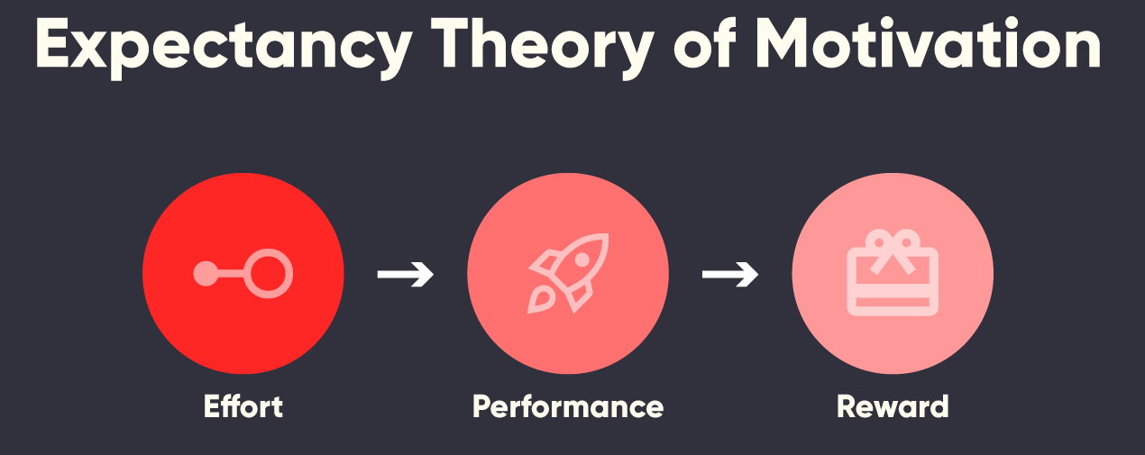

Connection to NMBC
Interviews reveal that the workers do not see a clear connection between effort and meaningful rewards, since there is no reward.
Workers like Zach and Carson see that some members of the team do not complete their assigned work and receive no consequences.
The workers also noted that there was inconsistent enforcement of authority from supervisors, and no structured performance evaluation system in place.
There is a lack of reward and performance evaluation system.

Slide 9
Connection to NMBC
From the manager's perspective, interviews with Nick (COO) show that the managers avoid confronting poor performance in the fear of stirring up team conflicts and tensions. As a result, high performing workers realize that their higher effort and better performance does not lead to better rewards–decreasing their motivation.
This means that expectancy and instrumentality were both weakened, since there is no reward for increased efforts. Additionally, many employees stated of being burnt out during busy seasons and having decreased motivation during slow seasons, thus reducing the valence of the work itself.

Slide 10
Output Problem #2 - Team Effectiveness Model
A Team Effectiveness Model is a framework to help organizations understand and improve how teams perform to reach their goals. The Team Effectiveness Model states that team performance depends on four different components.
1
2
3
4
Context
Leadership clarity, communication, and reward systems.
Work Design
Autonomy, skill variety, and task significance
Process
Shared SMART goals, good communication, and conflict management
Composition
Team diversity, skills, roles, and member characteristics

Slide 11
Connection to NMBC
NMBC’s output problems are linked to weak leadership clarity, peer-like management, and no reinforced performance standard.
Uneven skill levels reduce accountability and teamwork.
Lack of structured training and unclear goals undermine work design and process.

Slide 12
Connection to NMBC
Leadership
Employees described the workplace as “peer- like,” with managers acting more like friends than subordinates.
Rules are not enforced, and poor performance is rarely confronted.
Line staff notes confusion about scheduling, unclear expectations, and inconsistent instructions
Composition
Employees hesitate to hold peers accountable due to friendships and age similarities.
Experienced workers like Zach felt like they were carrying disproportionate workload.
Newer workers like Carson reported feeling under-trained and unsure of expectations.

Slide 13
Connection to NMBC
Work Design
New employees often “figure it out on the job” reducing consistent performance.
Lack of structured training limits skill development and makes newer workers less confident.
Experienced workers have autonomy, but task significance decreases when others do not contribute equally.
Uneven workload distribution causes frustration and reduces productivity.
Process
Employees reported that peak season felt like “getting through the day”, not working toward shared goals.
Team goals are not clear or “SMART”, reducing cohesion.
Conflicts are avoided, not addressed, due to friendships.
Communication gaps and sudden changes disrupt coordination during busy periods.

Slide 14
First Recommendation
Need for more Authority:
How to implement:
After conducting one-on-one meetings with staff and managers, a recurring suggestion was that managers, particularly Nick, need to adopt a more authoritative leadership approach.
Team effectiveness suffered due to the company’s struggles with implementing autonomy. Although Nick was physically present, he did not actively supervise staff, address concerns, or engage with daily operations.
Employees took advantage of this lack of oversight, using work hours to slack off without fear of consequences because they knew complaints rarely resulted in action.
Hold weekly staff meetings to discuss concerns, progress, and expectations.
Have Nick regularly walk around the office and assist with moves to increase visibility and accountability.
Implement an anonymous complaint form to encourage transparent reporting and ensure issues are taken seriously.

Slide 15

First Recommendation
Best Practices: management in Lebanese Healthcare
Potential Downsides
Found that workers at healthcare centers in Lebanon improved in team efficiency and problem solving if managers observed and engaged with them more
More present managers are able to build better relationships with employees and identify operational issues faster
Would be reflected by Nick’s increased presence at the office and introduction of complaint forms
Increasing the authority of management may cause worker autonomy to decrease if taken too far (important motivational factor)
  Ex: If Nick excessively watches over employees or takes too much control, workers might end up feeling micromanaged
Can eventually lead to another motivational problem
Also costs additional time and resources from Nick

Slide 16

Second Recommendation
Need Incentives to Increase Employee Motivation
How to Implement
During one-on-one discussions, a line staff member, Zach, expressed feeling overworked, stating, “I have to continuously pick up for other people's slack” (personal communication, October 20, 2025).
The core issue appeared to be low motivation among team members who relied on Zach’s consistent effort instead of contributing equally.
To address this imbalance, we recommended introducing performance-based incentives, including bonuses and an Employee of the Month program.
Offer monthly performance bonuses tied to clear, measurable goals.
Create an Employee of the Month recognition system to publicly acknowledge consistent strong performance.
Ensure rewards are distributed transparently and fairly to maintain trust among employees.

Slide 17

Second Recommendation
Best Practices: Walmart
Potential Downsides
Performance-based bonus program rewarded employees with incentives with good work and specific goals being met
Bonuses were shown to increase motivation and decrease slack at the company
  Tied rewards with performance outcomes
Providing similar incentives to employees at NMBC will offer similar increases in worker motivation
Providing extrinsic bonuses to employees could increase unhealthy competition and rivalry
People are naturally ambitious and have a desire for upward mobility
  Additional rewards will foster an ambitious attitude and promote competition
Although competition can be healthy, it can also lead to decreased team cooperation if taken too far
Additional monetary cost for extra bonuses and potential cost towards cooperation progress in the workplace

Slide 18
Communication strategies/influencing tactics
1: Establishing credibility
2: Providing our evidence
Need to establish our expertise and build trust with the company in order to gain their support
To build expertise:
  Taking extra preparation steps before meetings/understanding our own research clearly
To build trust:
  Hosting more meetings in-person, listening to the feedback and perspectives of their leadership
Goal is to be as transparent with the company as possible to strengthen our argument
Three methods will be used
  Use graphics during meetings that visually display important information
  Cite/explain where we derived all of our secondary sources/research
  Take extra time to explain important concepts and clear up any questions/confusion

Slide 19
Thank You

